Slide 1
MILESTONE 2 GROUP 3
Mapping the Philippine
Restaurant Landscape
Food-Type Diversity, Customer Engagement, and the Distribution of Restaurant Listings Across Selected Cities
Chaim 1st Presenter; Nathan 2nd Presenter; Arvin 3rd Presenter; Erika 4th Presenter
Foodpanda restaurant-listing dataset collected in 2025
Notes:
PRESENTER: Chaim
TARGET TIME: 15 seconds
SCRIPT
Good day, everyone. We are Group 3: Chaim, Nathan, Arvin, and Erika. Our study examines the Foodpanda restaurant listings captured across selected Philippine cities. We focus on food-type diversity, customer engagement, and how the listings are distributed.
SOURCES
- Final title and objectives supplied by Group 3

Slide 2
Study scope and general objective
GENERAL OBJECTIVE
Scope of the findings
To analyze the Philippine restaurant landscape across selected cities by examining food-type diversity, customer engagement, and the distribution of restaurant listings using a dataset of Foodpanda restaurant listings collected in 2025.
The study describes restaurant-listing records captured in the dataset.
It does not estimate every operating restaurant or the eating habits of all Filipinos.
Milestone 2, Group 3
2
Notes:
PRESENTER: Chaim
TARGET TIME: 25 seconds
SCRIPT
Our general objective is to analyze the restaurant landscape represented in this 2025 Foodpanda dataset. The scope is important. We are describing restaurant-listing records in the selected cities. We are not estimating the complete number of operating restaurants, and we are not measuring the food preferences of every Filipino.
SOURCES
- Group 3 finalized general objective
- Foodpanda 2025 Raw Data.csv

Slide 3
Six specific objectives
01
Clean and prepare
02
Compare food-type diversity
Document missing values, repeated IDs, unrated listings, text issues, and unusual reviewer counts.
Measure the number and proportional representation of known food types across cities.
03
Assess customer engagement
04
Examine listing distribution
Compare reviewer counts and average ratings among rated listings.
Compare listing counts, percentage shares, and city-by-food-type summaries.
05
Explore relationships
06
Communicate clearly
Use descriptive comparisons and Spearman correlation without claiming causation.
Present six labeled charts with plain-language findings and limitations.
Milestone 2, Group 3
3
Notes:
PRESENTER: Chaim
TARGET TIME: 30 seconds
SCRIPT
Our six objectives follow the complete analysis process. First, we cleaned and documented the dataset. Second, we compared food-type diversity. Third, we assessed reviewer activity and ratings. Fourth, we examined the distribution of listings. Fifth, we explored the relationships among these measures using Spearman correlation. Finally, we communicated the findings through six charts and clear limitations.
SOURCES
- Group 3 finalized specific objectives

Slide 4
The dataset contains 12,409 listing records
Six original columns cover 18 selected city labels
12,409
18
67
91
restaurant-listing records
city labels
known food-type categories
missing food-type values
Original columns
How one row is interpreted
StoreId
CompleteStoreName
FoodType
AverageRating
Reviewers
City
One row represents one listing record. Repeated store identifiers mean a row cannot automatically be treated as one verified, unique restaurant.
Milestone 2, Group 3
4
Notes:
PRESENTER: Chaim
TARGET TIME: 25 seconds
SCRIPT
The raw file has 12,409 listing records and six original columns. It includes 18 city labels and 67 known food-type categories. Ninety-one listings have no food-type value. One row represents one listing record. Since some store identifiers repeat, we avoid calling every row a verified, unique operating restaurant.
SOURCES
- Foodpanda 2025 Raw Data.csv
- Data Cleanup - Milestone 2.ipynb, inspection section

Slide 5
Cleaning decisions preserved the full dataset
No listing records were deleted
Issue
Finding
Decision
Missing FoodType
91 values
Filled with Unknown
Text formatting
Spaces and lowercase city labels
Trimmed and standardized
Repeated StoreId
67 identifiers across 134 rows
Retained for investigation
Unrated listings
3,037 with zero reviewers and rating
Separated from rating analysis
Reviewer outliers
1,517 above the IQR limit
Flagged and retained
Milestone 2, Group 3
5
Notes:
PRESENTER: Chaim
TARGET TIME: 35 seconds
SCRIPT
The cleaning process kept all 12,409 records. We filled 91 missing food types with Unknown and standardized text formatting. We retained the 134 rows with repeated identifiers because they were not exact duplicate rows. We created separate fields for reviewed and unrated listings so zero ratings would not lower the averages. We also used the IQR method to flag 1,517 unusually high reviewer counts. We kept them because a high count may represent genuine engagement.
SOURCES
- Data Cleanup - Milestone 2.ipynb
- Foodpanda 2025 Cleaned Data.csv

Slide 6
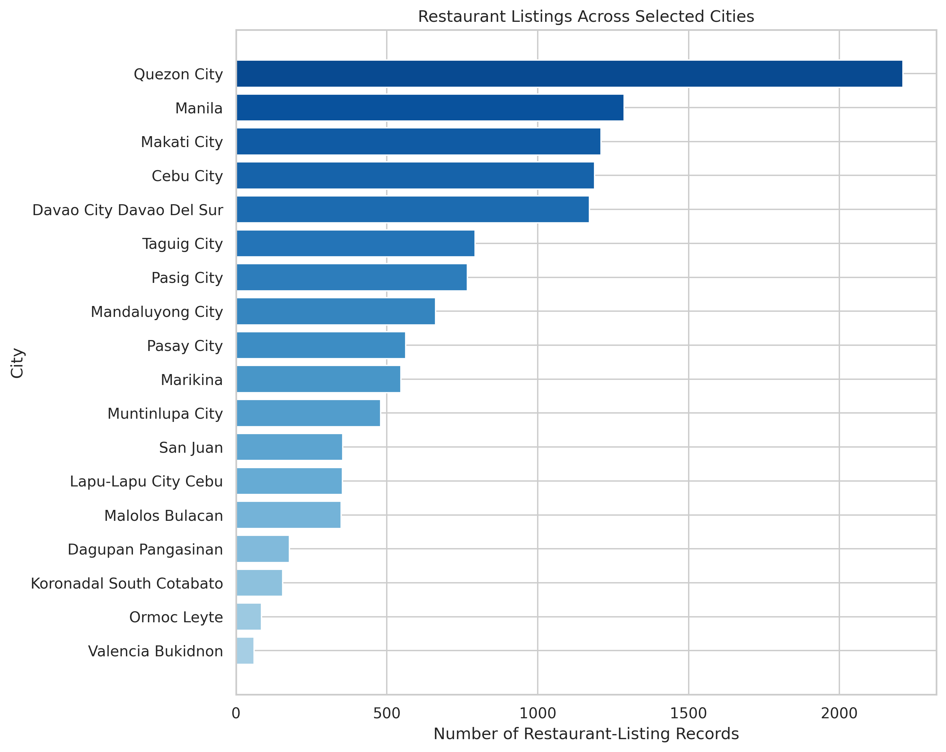
Restaurant listings are unevenly distributed
Specific Objective 4: listing counts and city shares
What the chart shows
Quezon City has 2,211 listings, or 17.82% of the dataset.
The five largest city groups contain 56.95% of all records.
Valencia, Bukidnon has 60 listings, or 0.48%.
Milestone 2, Group 3
6
Notes:
PRESENTER: Chaim
TARGET TIME: 35 seconds
SCRIPT
The first result shows an uneven distribution of listing records. Quezon City has 2,211 listings, which is 17.82 percent of the dataset. The five largest city groups contain about 56.95 percent of all records. Valencia, Bukidnon has 60 listings. These values describe dataset coverage, so they should not be interpreted as a complete restaurant census. Nathan will now present the remaining findings.
SOURCES
- Data Analysis - Milestone 2 - Group 3.ipynb, city distribution
- Foodpanda 2025 Cleaned Data.csv

Slide 7
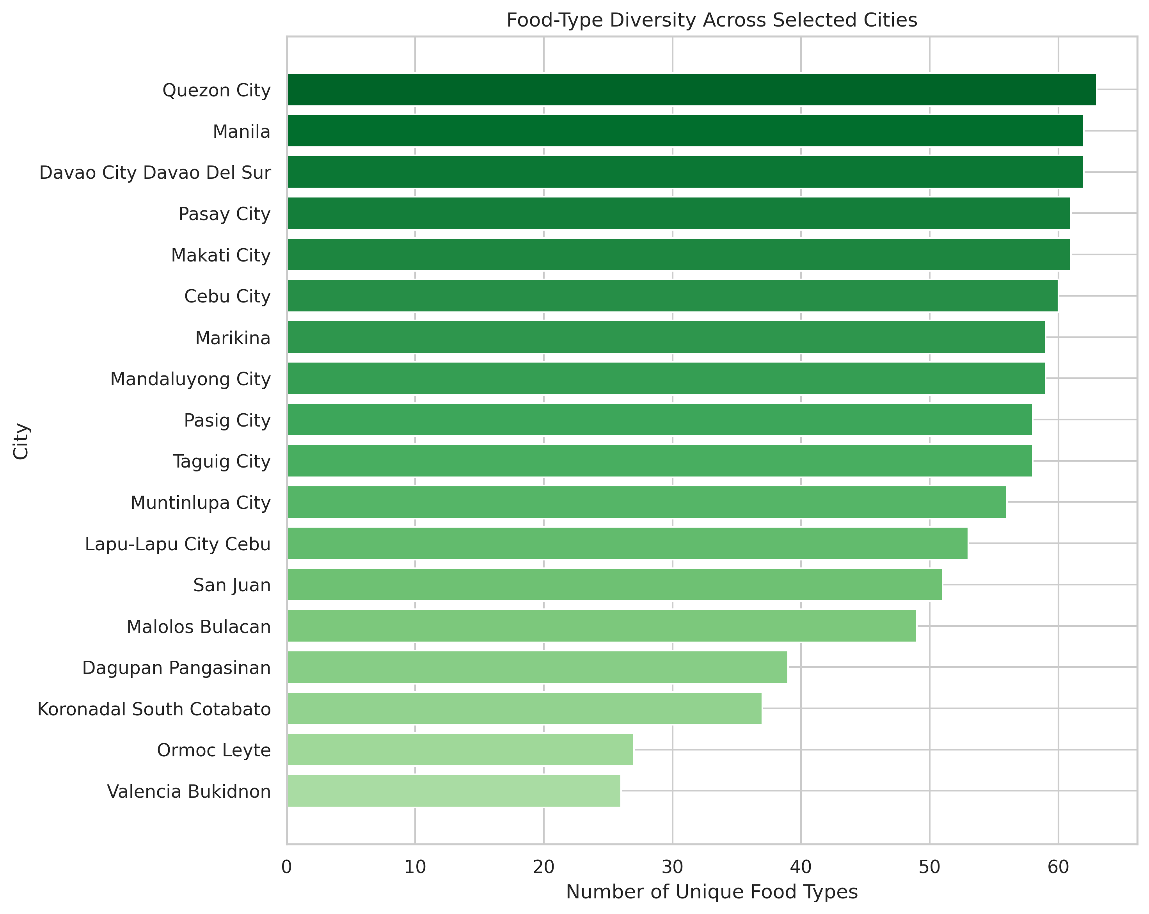
Food-type variety differs across the selected cities
Specific Objective 2: unique known food types
What the chart shows
Quezon City records 63 known food types.
Davao City and Manila each record 62.
Valencia records 26. Its smaller listing count limits the variety captured.
Milestone 2, Group 3
7
Notes:
PRESENTER: Nathan
TARGET TIME: 30 seconds
SCRIPT
Food-type diversity means the number of unique known food categories recorded in each city. Quezon City has the widest represented variety with 63 categories. Davao City and Manila each have 62, while Valencia has 26. Cities with more captured listings have more opportunities to record different categories, so this comparison partly reflects dataset coverage.
SOURCES
- Data Analysis - Milestone 2 - Group 3.ipynb, city diversity
- Unknown food types excluded

Slide 8
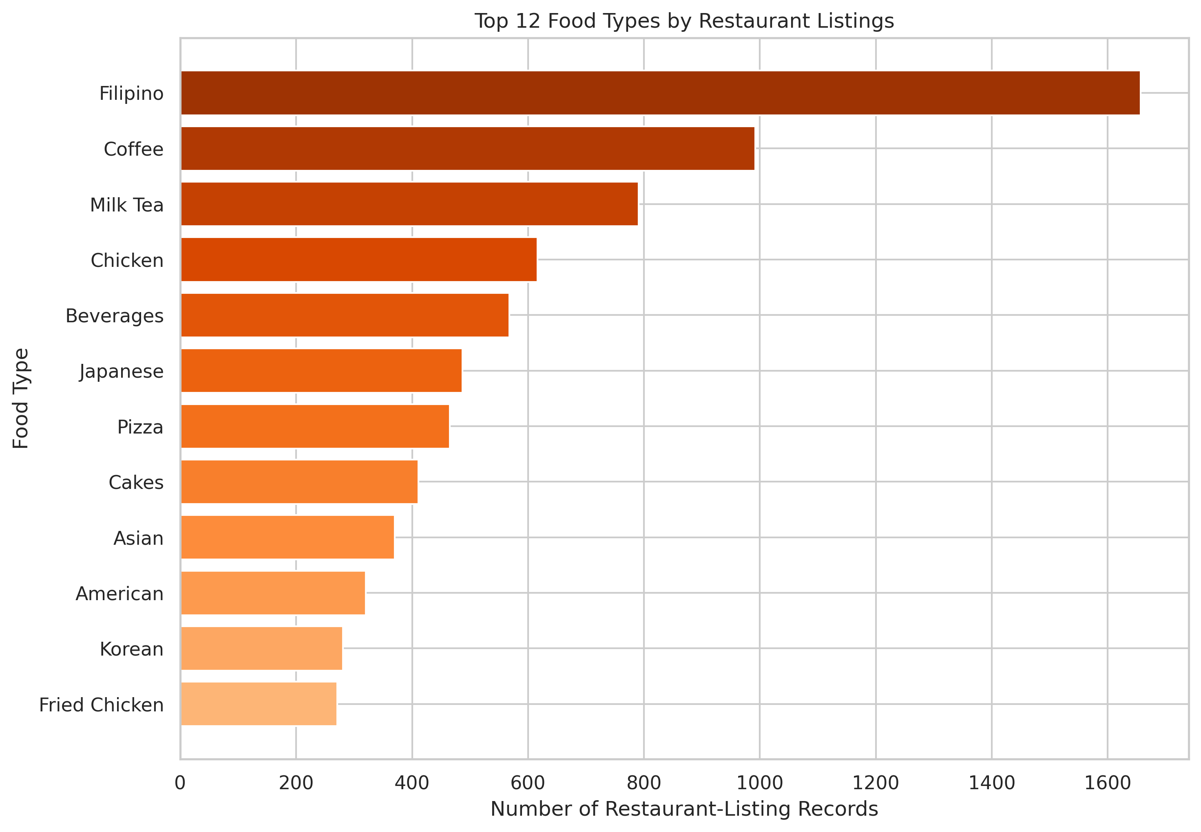
Filipino food is the most represented category
Specific Objectives 2 and 4: category representation
Leading categories
Filipino: 1,657 listings, or 13.45% of known-food records.
Coffee: 992 listings, or 8.05%.
Milk Tea: 791 listings, or 6.42%.
Milestone 2, Group 3
8
Notes:
PRESENTER: Nathan
TARGET TIME: 25 seconds
SCRIPT
Filipino food is the most represented known category, with 1,657 listings. Coffee follows with 992, and Milk Tea has 791. These percentages use only listings with a known food type. They show how categories are represented on the platform dataset. They do not show actual customer preference or food consumption.
SOURCES
- Data Analysis - Milestone 2 - Group 3.ipynb, food distribution
- Unknown food types excluded

Slide 9
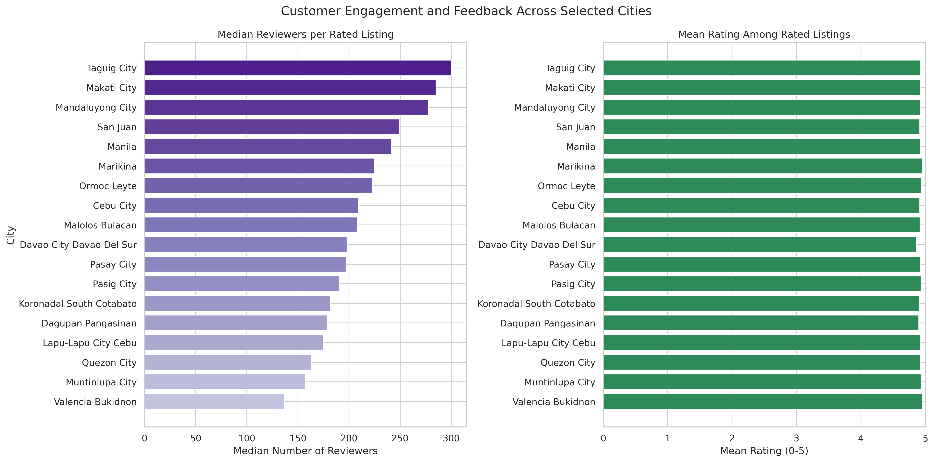
Reviewer activity varies more than average ratings
Specific Objective 3: engagement and feedback among rated listings
How to read it
Median reviewer counts range from 137 to 300.
City mean ratings remain between 4.87 and 4.96 out of 5.
The median represents the typical middle listing and reduces the influence of extreme reviewer counts.
Milestone 2, Group 3
9
Notes:
PRESENTER: Nathan
TARGET TIME: 35 seconds
SCRIPT
For customer engagement, we examined reviewer counts only among the 9,372 rated listings. The typical, or median, reviewer count ranges from 137 to 300 across cities. We used the median because reviewer counts are very uneven and include extreme values. Average ratings show much less variation. The city means stay between approximately 4.87 and 4.96 out of five.
SOURCES
- Data Analysis - Milestone 2 - Group 3.ipynb, city engagement
- Rated listings only, n = 9,372

Slide 10
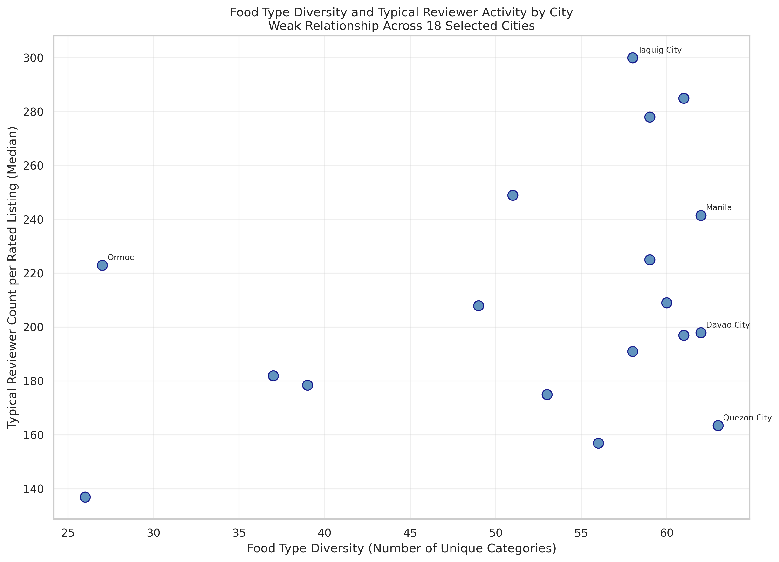
Diversity does not clearly predict typical reviewer activity
Specific Objective 5: Spearman correlation
Three relationship checks
0.938
Spearman rho Listings and food types
Strong positive pattern, likely affected by coverage.
0.274
Spearman rho Food types and median reviewers
Weak pattern, p = 0.271. Evidence is insufficient.
0.289
Spearman rho Reviewers and average rating
Weak positive pattern, p < 0.001.
Correlation describes association. It does not establish cause and effect.
Milestone 2, Group 3
10
Notes:
PRESENTER: Nathan
TARGET TIME: 50 seconds
SCRIPT
We used Spearman correlation because reviewer counts are highly uneven and contain extreme values. A strong relationship appears between listing count and the number of food types, with rho equal to 0.938. This likely reflects coverage because more listings create more opportunities to capture categories. Food-type diversity and typical reviewer activity have a weak relationship, with rho equal to 0.274 and a p-value of 0.271. That p-value means the city-level evidence is insufficient to confirm a relationship. Reviewer count and average rating also have a weak positive relationship, with rho equal to 0.289. These are associations and do not prove cause and effect.
SOURCES
- Data Analysis - Milestone 2 - Group 3.ipynb, Spearman tests
- 18 city-level observations for the first two tests
- 9,372 rated listings for reviewer count and rating

Slide 11
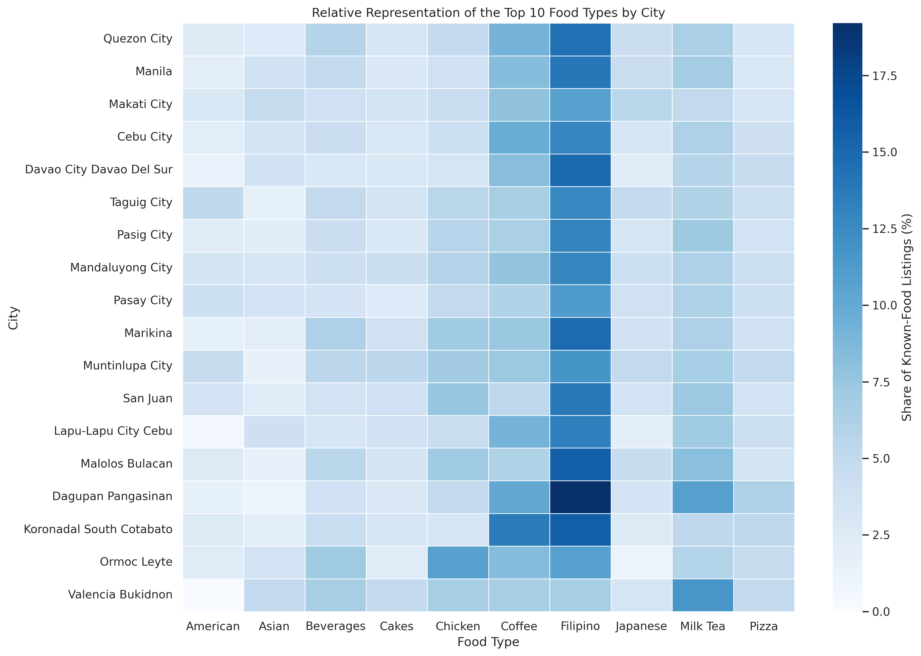
Food-type shares reveal different city-level mixes
Specific Objectives 2 and 4: proportional representation
How to read it
Darker blue means a larger share within a city.
Filipino food leads among the top ten categories in 16 of 18 cities.
Chicken leads in Ormoc. Milk Tea leads in Valencia.
Milestone 2, Group 3
11
Notes:
PRESENTER: Nathan
TARGET TIME: 30 seconds
SCRIPT
This heatmap compares the percentage share of the ten leading known food types within each city. Darker blue represents a larger share. Filipino food has the largest share among these categories in 16 of the 18 cities. Chicken leads in Ormoc, while Milk Tea leads in Valencia. The heatmap helps us compare category mix even when cities have very different listing totals.
SOURCES
- Data Analysis - Milestone 2 - Group 3.ipynb, city-food heatmap
- Percentages use known-food listings within each city

Slide 12
Main findings and limitations
Specific Objective 6: plain-language communication
What the dataset shows
What limits the conclusions
Listing coverage and food-type variety differ across cities.
Filipino food is the most represented known category.
Reviewer activity varies more than city average ratings.
Food-type diversity has only a weak, non-significant city-level relationship with typical reviewer activity.
The dataset covers Foodpanda listings rather than every operating restaurant.
Unequal city coverage affects comparisons.
Missing food types and repeated IDs may reflect platform or collection limitations.
The original source, collection method, and reuse terms still require confirmation.
Correlation does not prove causation.
Conclusion: The dataset shows a varied but unevenly captured restaurant-listing landscape across the selected cities.
Milestone 2, Group 3
12
Notes:
PRESENTER: Nathan
TARGET TIME: 40 seconds
SCRIPT
In summary, the listing totals and food-type variety differ across the selected cities. Filipino food is the most represented known category. Reviewer activity varies, while city average ratings remain close to five. Greater food-type diversity does not clearly correspond to higher typical reviewer activity. These findings must remain within the dataset's limits. Foodpanda listings do not represent every operating restaurant, city coverage is uneven, and correlations do not prove causation. We also need to confirm the original source and reuse terms before submission. Next, Arvin and Erika will show the code behind the cleaning and analysis.
SOURCES
- Data Analysis - Milestone 2 - Group 3.ipynb, findings and limitations

Slide 13
Notebook walkthroughs
ARVIN
ERIKA
Data Cleanup
Data Analysis and EDA
1. Load and inspect the raw data
2. Check missing values and repeated IDs
3. Separate unrated listings
4. Flag reviewer-count outliers
5. Validate and save the cleaned CSV
1. Load and segment the cleaned data
2. Build grouped and pivot summaries
3. Produce the six charts
4. Apply the Spearman tests
5. Explain findings and limitations
Milestone 2, Group 3
13
Notes:
PRESENTER: Nathan, Arvin, and Erika
TARGET TIME: Nathan 10 seconds, Arvin 60 seconds, Erika 75 seconds
SCRIPT
NATHAN TRANSITION: We will now show how the notebooks produced these results. Arvin will begin with data cleanup, followed by Erika for the exploratory data analysis.
ARVIN SCRIPT: I will briefly show the Data Cleanup notebook. We first loaded the raw CSV and inspected its shape, data types, missing values, exact duplicates, and repeated StoreId values. We filled the 91 missing FoodType values with Unknown and standardized text. We created HasReviews to identify listings with customer reviews, and RatingForAnalysis to keep unrated records out of rating averages. We used the IQR method to flag 1,517 unusually high reviewer counts, but we retained them because they were not confirmed errors. Finally, we validated all 12,409 records and saved the cleaned CSV.
ERIKA SCRIPT: I will show the Data Analysis notebook, also called EDA or Exploratory Data Analysis. We loaded the cleaned CSV and separated known-food listings from rated listings. We used groupby to summarize listings, unique food types, reviewer counts, and ratings by city and food type. We created a pivot table for the city-by-food comparison and generated six charts. We then used Spearman correlation because reviewer counts are uneven and contain extreme values. The results were 0.938 for listings and diversity, 0.274 for diversity and median reviewers, and 0.289 for reviewers and ratings. We interpreted these as associations only and included the dataset limitations.
SOURCES
- Data Cleanup - Milestone 2.ipynb
- Data Analysis - Milestone 2 - Group 3.ipynb

